Slide 1
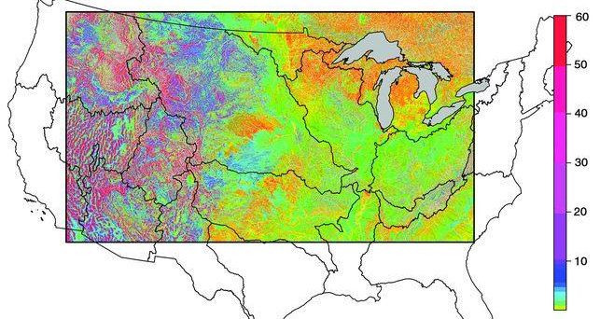


Cloud Software for enabling community-oriented integrated hydrologic modeling
Anthony M Castronova¹, Danielle Tijerina², Scott Black³, David G Tarboton⁴, Laura E Condon⁵, Hoang Tran⁶, Ahmad Rezaii⁷, Catherine Olschanowsky⁸, Shweta Purawat⁹, Jerad Bales¹, Michelle Strout¹⁰, Ilkay Altintas⁹, Lisa Gallagher¹¹ and Reed M Maxwell¹²
(1)Consortium of Universities for the Advancement of Hydrological Science, Washington, DC, United States, (2)Colorado School of Mines, Golden, CO, United States, (3)Utah State University, Utah Water Research Laboratory, Logan, United States, (4)Utah State University, Logan, UT, United States, (5)University of Arizona, Hydrology and Atmospheric Sciences, Tucson, AZ, United States, (6)Colorado School of Mines, Department of Geology and Geological Engineering, Golden, CO, United States, (7)Boise State University, Boise, United States, (8)Boise State University, Computer Science, Boise, ID, United States, (9)University of California San Diego, La Jolla, CA, United States, (10)University of Arizona, Computer Science, Tucson, AZ, United States, (11)Colorado School of Mines, Integrated Groundwater Modeling Center, Golden, CO, United States, (12)Princeton University, Princeton, NJ, United States
Maxwell & Condon, 2016
Notes:
Identified as a grand challenge in hydrology, high-resolution, continental-scale simulations are essential to addressing and predicting hydrologic response to a range of stressors on spatial and temporal scales previously unattainable. Modeling at this scale requires large, labor intensive, input datasets that are curated by teams of interdisciplinary scientists. While hosting these datasets in cloud accessible formats is a necessary first step towards community engagement, we must also provide the ability to execute and collaborate around them at local and regional scales to broaden intellectual contribution.
A couple of years ago CUAHSI began developing a web tool for extracting domain data for these types of models at smaller, watershed, scales. This work was initially presented in 2018 and effectively launched the CUAHSI Subsetter application. This was a originally a collaboration between CUAHSI and NCAR. We’ve since broadened our collaboration as part of the NSF HydroFrame project.
In this presentation, I will discuss work that has been completed as part of the HydroFrame project to support research and educational applications of the CUAHSI Subsetter for the NWM (versions 1 and 2) and Parflow Conus (version 1).
The HydroFrame project (www.hydroframe.org) brings together hydrologists and computer scientists to build an end-to-end workflow for continental scale simulation
Presentation Notes:
Answer “So What?” question for every in-depth/technical statement
Title Slide
Explain goal of work, major questions that will be asked.
Include image and talk about it.
Slide Design:
Bullets kill presentations
Pictures are always better
Use callout boxes to point to images instead of bullets
Slide title
take away message (28pt font minimum, no more than two lines)
Last slide:
Title: If the audience could only take away one thing
Major items/takeaways/conclusions that lead to takeaway message. These can be bullets.
Leave slide up for Q/A, animate in contact information.

Slide 2
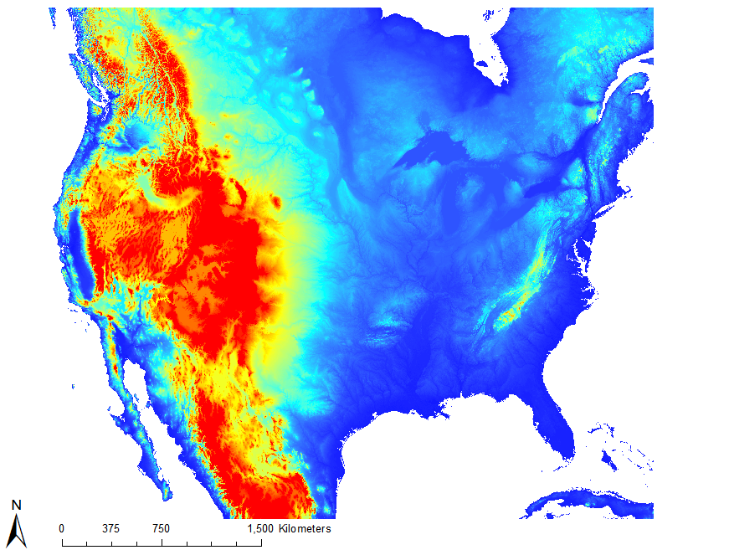
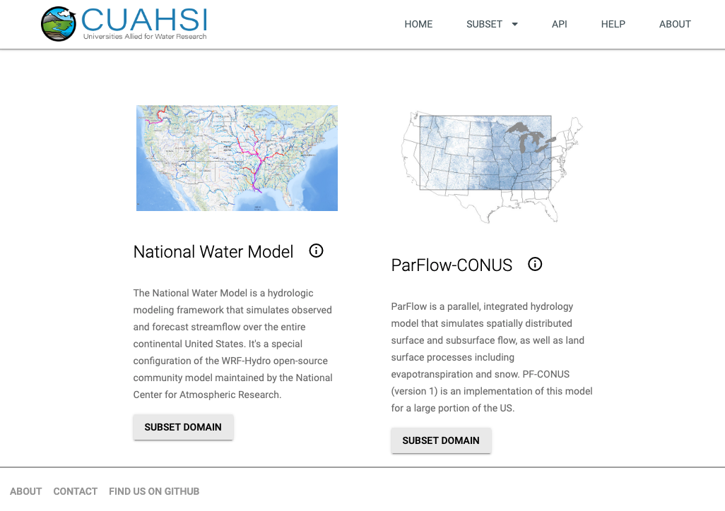
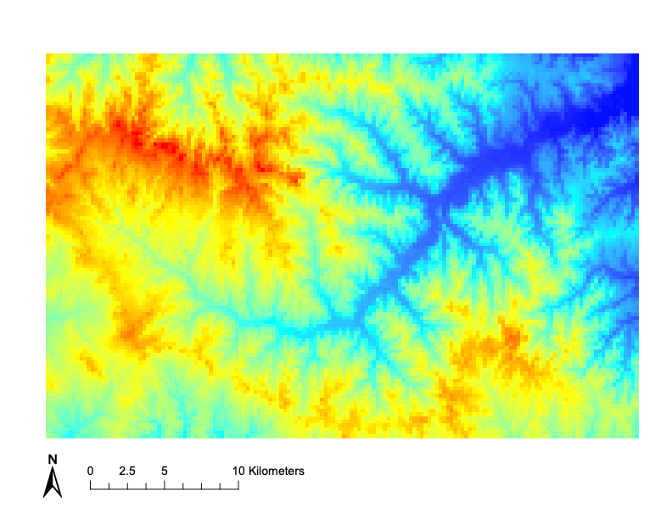
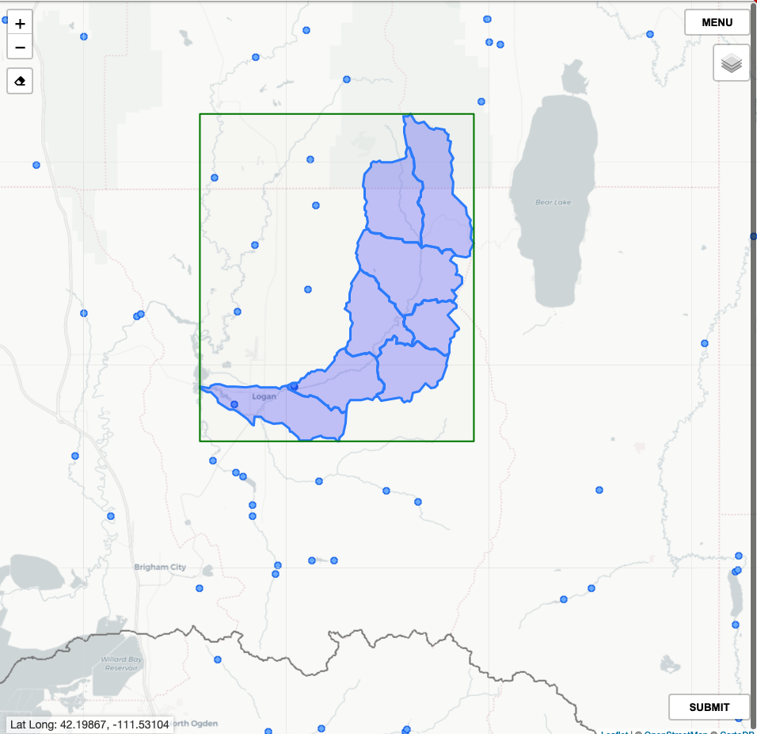
The CUAHSI Subsetter is designed to extract static domain data from CONUS models
~ 30 Gb ~ 70 Mb
https://subset.cuahsi.org
Notes:
What is the CUAHSI Subsetter? Key points from prior work
Project goals (CUAHSI Specific)
lower the barrier of entry to conus models
align watershed and regional studies with conus efforts using a common hydrofabric
broaden community engagement through educational activities.

Slide 3
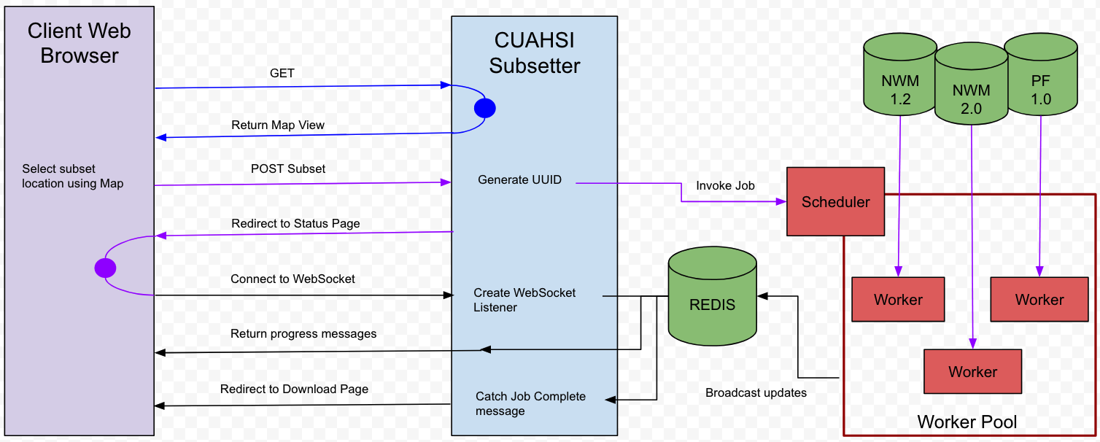
A flexible software pattern has enabled us to interface with multiple model development teams
Workers can be designed to leverage advanced CI
Notes:
Aligning with model development efforts is critical to ensure that subsetting algorithms are correct and up-to-date
pool of workers is decoupled from the web interface. This allows us to update and extend support for various models.
This pattern is flexible and will allow us to leverage advanced computing hardware which I will talk about in later slides.

Slide 4

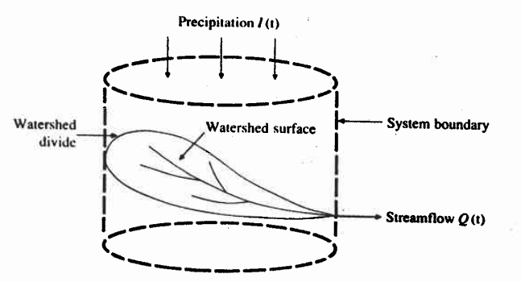
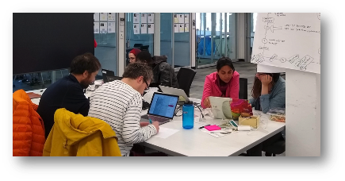
This software lowers the barrier to entry but still requires in-depth knowledge
Meteorological Forcing: wind, air temperature, specific humidity, precipitation, long/short wave radiation.
Domain: computational grid (x,y,z), static datasets (slope, manning’s coefficient, water pressure, land cover, etc.
Te Chow, V. (2010). Applied hydrology. Tata McGraw-Hill Education.
Model Execution
Notes:
Prior user assumptions
Original audience
Researcher or graduate student
Working alone
Probably someone that’s already doing research around this model or in a group that has experience running this model.
Knowledge and computer resources to process and execute model simulations
New/potential audiences
“Failed in EDU”
The curve is still too high for this to be used outside of an intensive workshop.

Slide 5
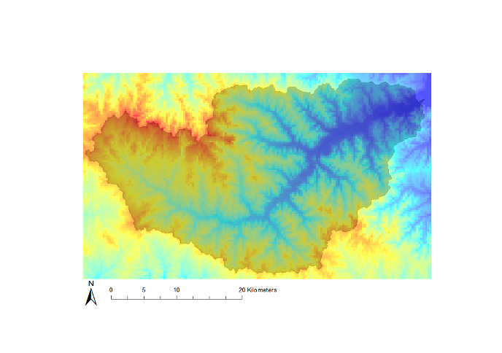
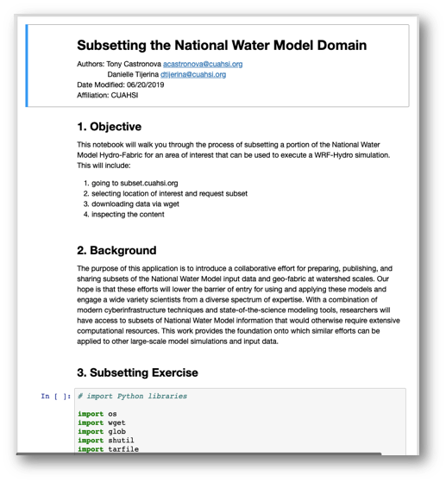
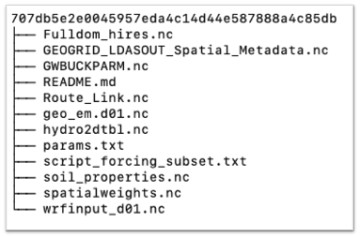
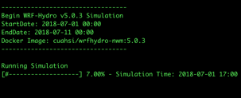
The barrier is high for educational activities outside of intensive workshops
Models are executed locally which requires compiling source code.
Notes:
In past work, we’ve explored using the subsetter in workshops
Notebooks for subsetting domain, collecting forcing, and analyzing output
Model execution needed to run locally
this is non-trivial
Compiling source code
Using Docker.

Slide 6
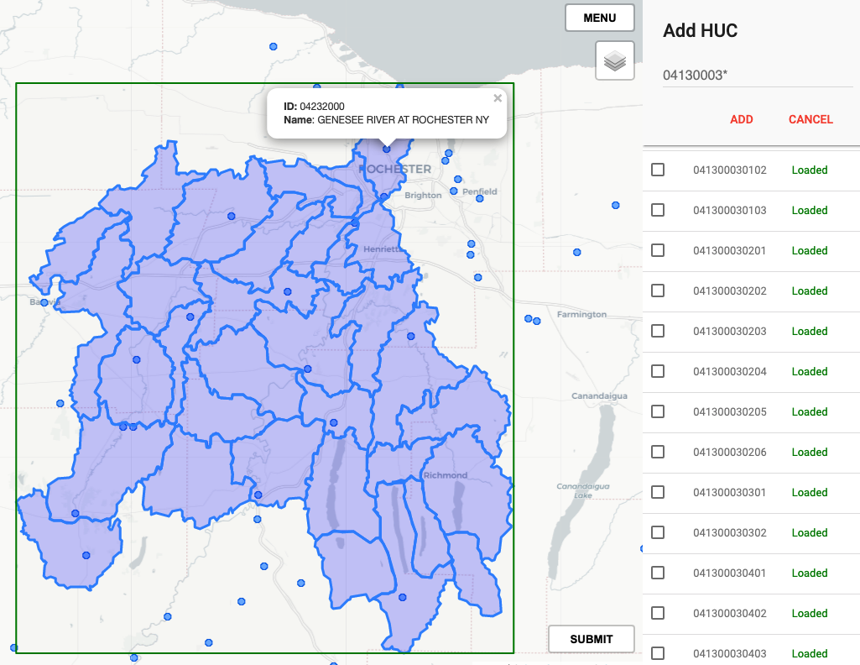
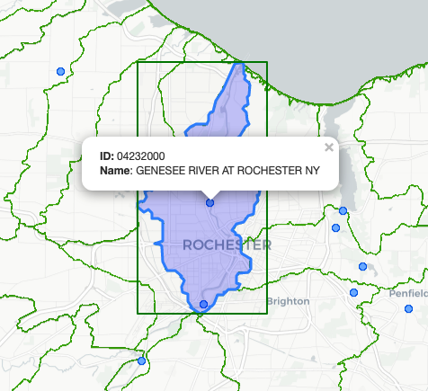
User interface enhancements make finding and selecting study areas easy
Expand selection by manually adding HUC ID’s or by using wildcards (*), e.g. 04130003* selects a level 8 HUC.
Notes:
NWIS gages help users find area of interest
Selecting by HUC (wildcard *) enable upstream tracing
User notifications during extraction improve our ability to detect and resolve software bugs.
So What?
improving ability to select locations is nice for researchers, however this is essential for educational activities such as classroom exercises or workshops activities. For instance, it’s not reasonable to ask participants of a class to manually select numerous HUCs. This is time consuming, tedious, and error prone.

Slide 7
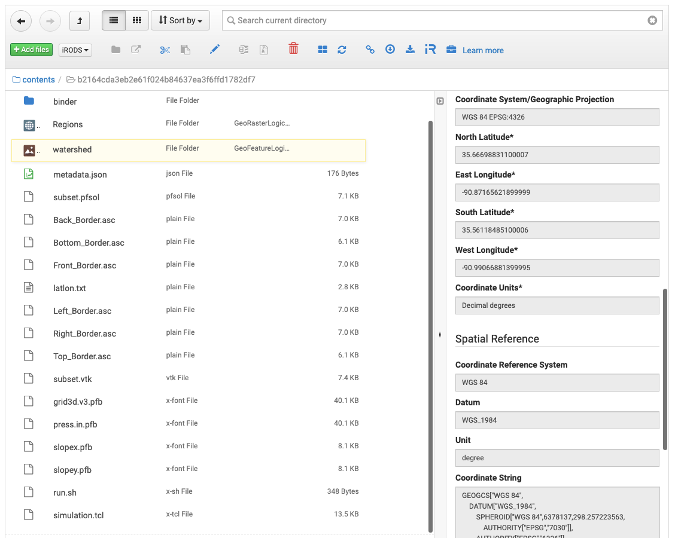
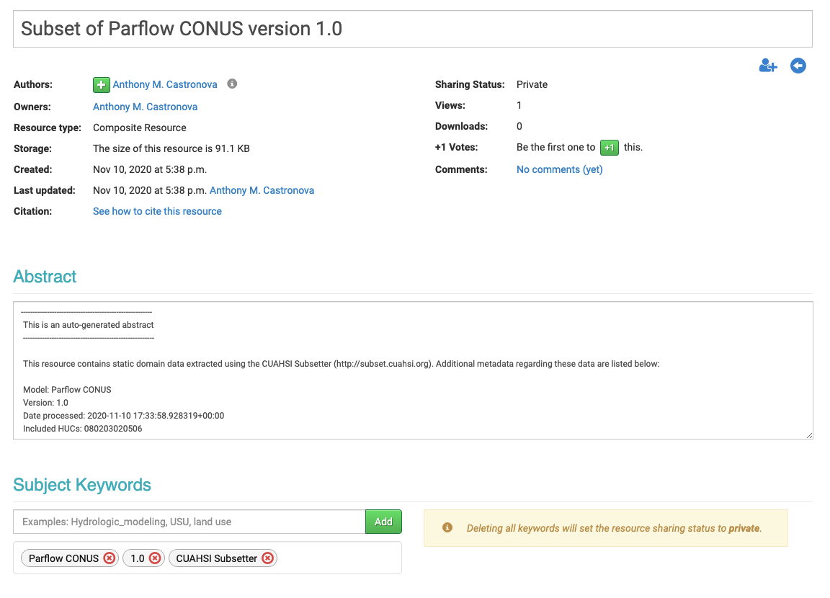
Connecting with HydroShare enables collaboration, archival, and publishing
Parsed Spatial Metadata
Automatically Generated Metadata
Ready for Execution
Compatible with HydroShare Apps
Notes:
Notable (cyberinfrastructure) changes and updates to the subsetter
Integration with data repository
Cloud computing
Extending to different models, i.e. Nwm 2.0 support
Reworking PFCONUS backend

Slide 8
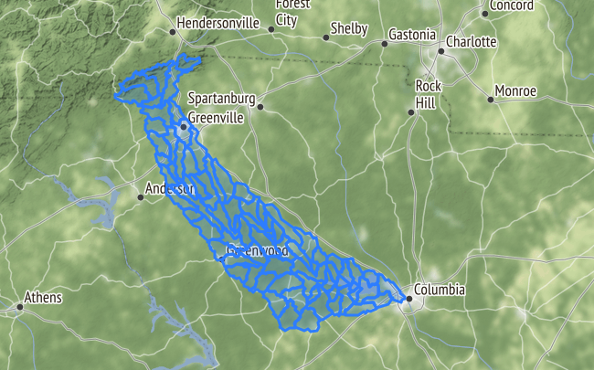
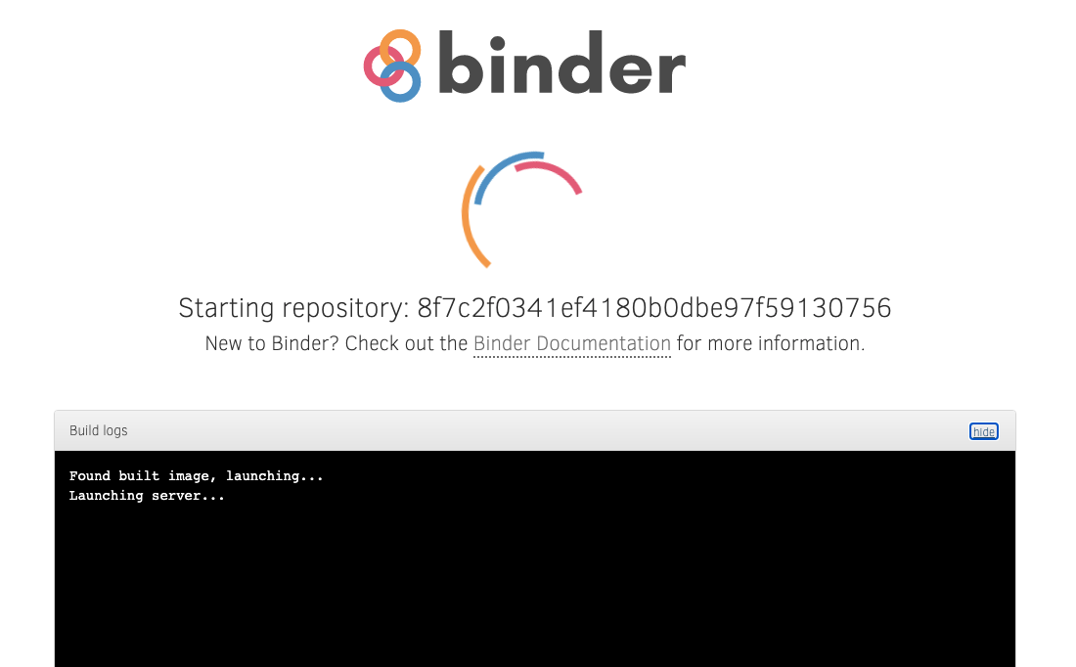
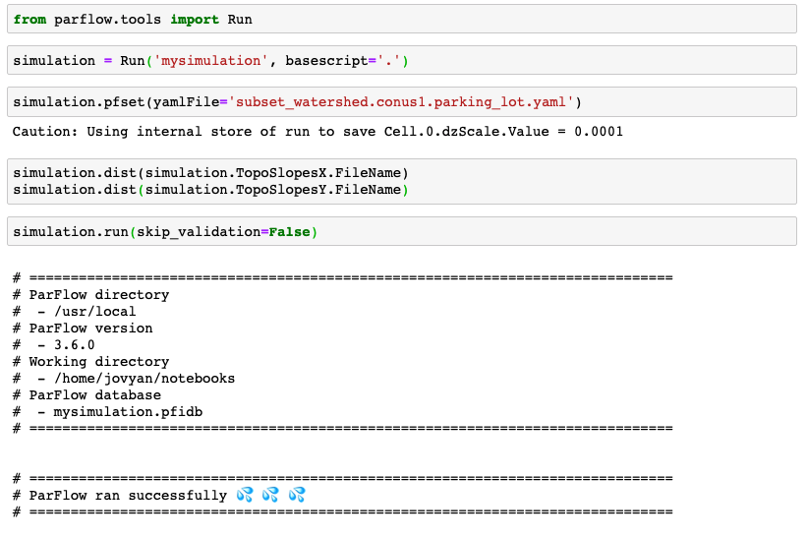
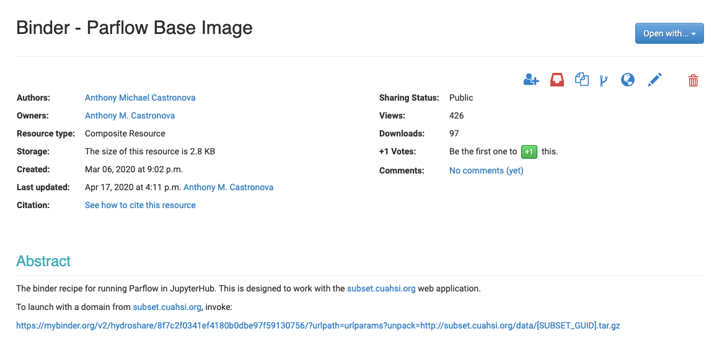
Executing model subsets in the cloud directly supports educational activities
Notes:
Notable (cyberinfrastructure) changes and updates to the subsetter
Integration with data repository
Cloud computing
Extending to different models, i.e. Nwm 2.0 support
Reworking PFCONUS backend

Slide 9
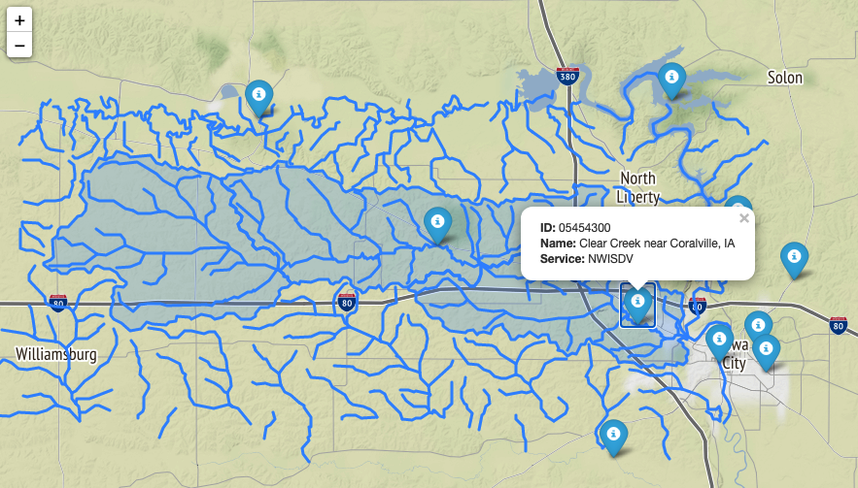
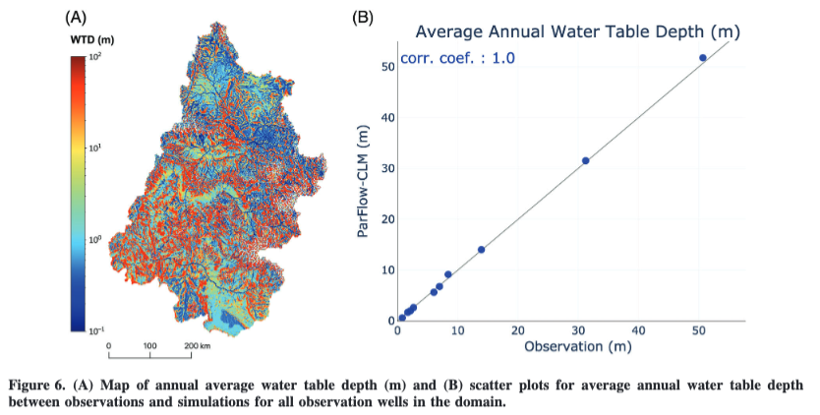
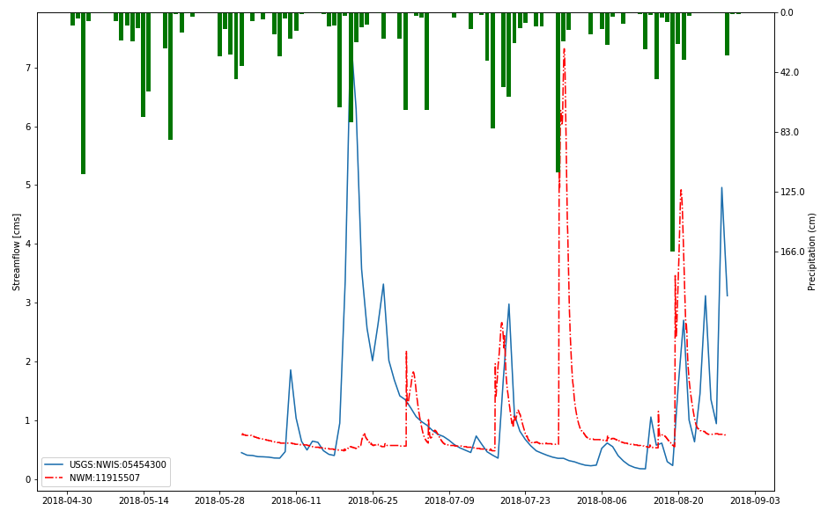
Supporting several models encourages intercomparisons, regional studies, and process analysis
Tran, H., Zhang, J., Cohard, J. M., Condon, L. E., & Maxwell, R. M. (2020). Simulating groundwater‐streamflow connections in the Upper Colorado River Basin. Groundwater, 58(3), 392-405.
Notes:
Notable (cyberinfrastructure) changes and updates to the subsetter
Integration with data repository
Cloud computing
Extending to different models, i.e. Nwm 2.0 support
Reworking PFCONUS backend
253100 km2 -> 270 km2
~900x the size of clear creek

Slide 10
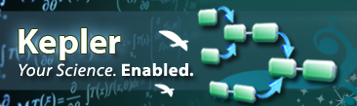
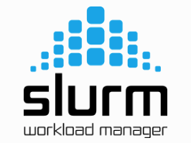
Advanced CI will enable us to support a wide variety of research and educational use cases
CUAHSI Subsetting Server
Worker
Worker
Worker
Worker
Kepler API Server
Subset Forcing and Results
Interactive Session
Subsetting API Server
Execute Simulation
Perform Subsetting
Notes:
Future Directions (Princeton Hardware)
9. Multiple workflows to support multiple use cases
Model execution
Forcing and results subsetting

Slide 11

The virtual modeling ecosystem directly supports education, research, and community engagement
Contact
Dr. Anthony Castronova
Hydrologic Scientist, CUAHSI
acastronova@cuahsi.org
Supports CONUS Models - NWM 1.2, NWM 2.0, PF-CONUS 1.0
HydroShare enables collaboration, data archival, and data publication
Cloud computing platforms, e.g. MyBinder, support educational activities
Plans to leverage advanced CI to support a wide array of use cases
Community engagement has the potential to broaden intellectual contribution
https://subset.cuahsi.org
Notes:
11. Conclusions and Broader Impact

